Slide 1
Examining a gene cluster encoding a bacteriocin of the gut bacterium B. fragilis
Comparative Genomics
4/25/19
Vincent DiMassa

Slide 2
The Human Microbiome
10-100 trillion microbial cells
Bacteria, fungi, protozoa and viruses
Outnumber human cells 10 to 1
Outnumber human genes 200 to one
Majority live in the gut

Slide 3
Background
Bacteroides fragilis
– common constituent of the human colon
– anaerobic, generally commensal
– Bf ^{N} strain kills Bf ^{H} strain (type-VI secretion system independent)

Slide 4
Identifying the necessary genes
Two loci were identified
Locus 1: 2671 (Fpn)
Locus 2: 1466, 1465, 1464
Hypothesized Mechanism
Fpn
B. fragilis killing
1466 protein
Notes:
Questions:
Do other bacterial species harbor this gene?
Is this a competitive factor limited to and specifically utilized in gut bacteria?

Slide 5
Initial questions
1. to better understand gene cluster occurrence across phylogenies and to determine whether they are gut bacteria restricted
2. to determine the co-occurrence patterns of the genes in question 1466, 1465, 1464, and 2671
3. to identify the genomic island boundaries for this gene cluster
4. to determine amino acid conservation across homologues
5. to understand co-occurrence patterns of other genes specific to cluster (+) and cluster (-) genomes
Notes:
Understanding competitive factors that influence a bacteria’s survival in gut is crucial to designing effective probiotics and replacement therapies, as many currently only exist in the gut landscape transiently.

Slide 6
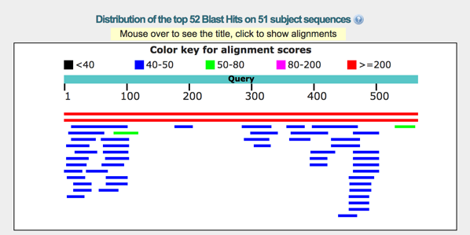
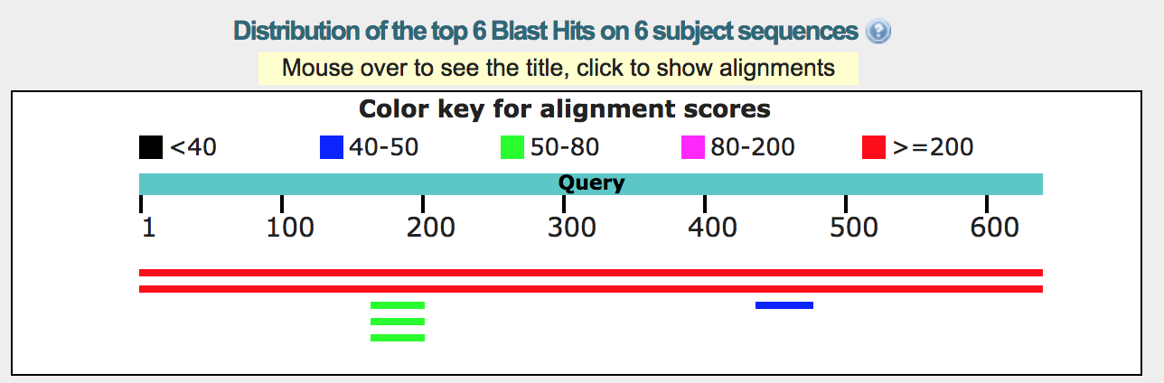
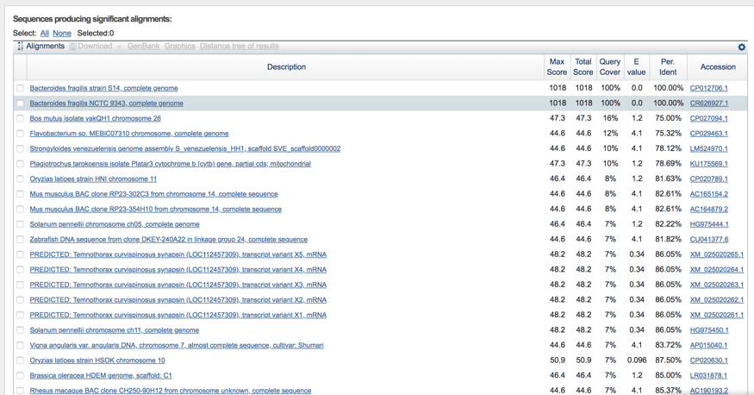
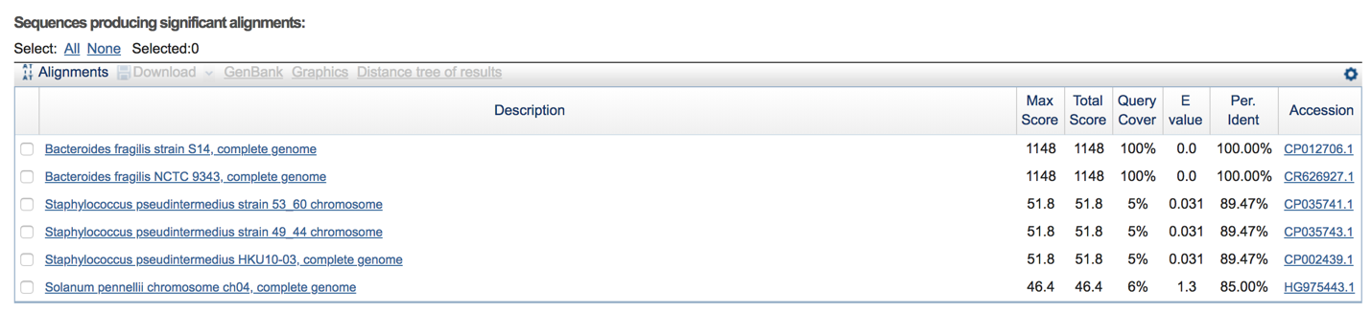
NCBI BLAST – only B. fragilis genes were found
Gene “1464”
Gene “1465”
Notes:
First, just wanted to see if I could find any of the genes in the database belonging to organisms other than B. fragilis.

Slide 7

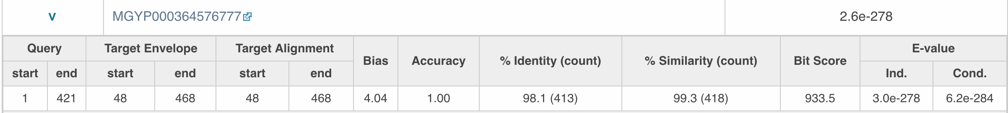
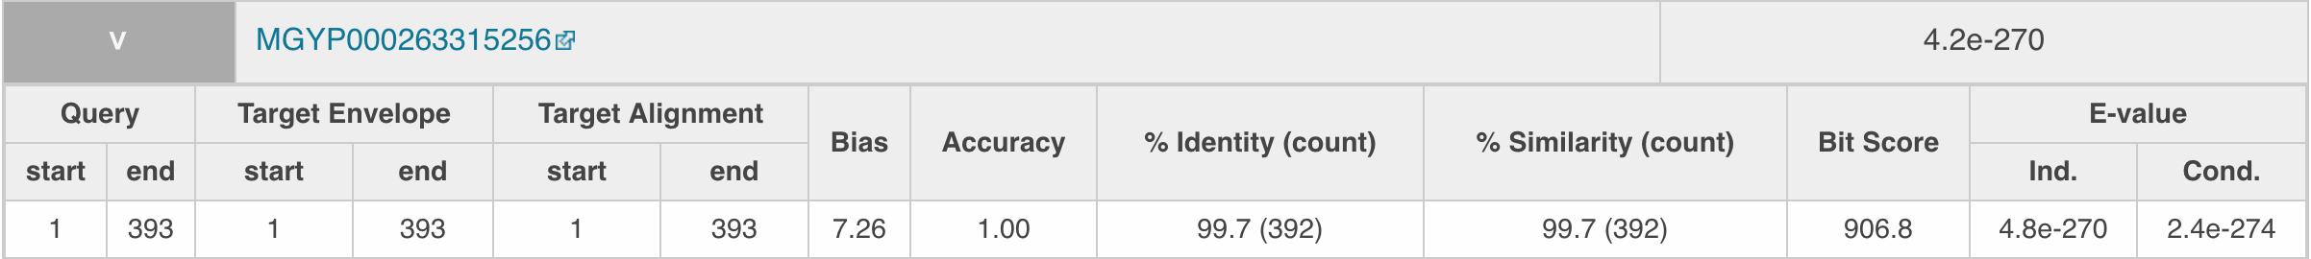
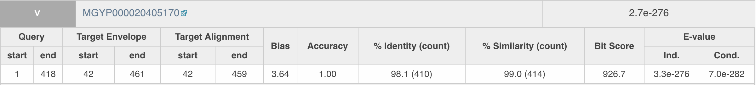
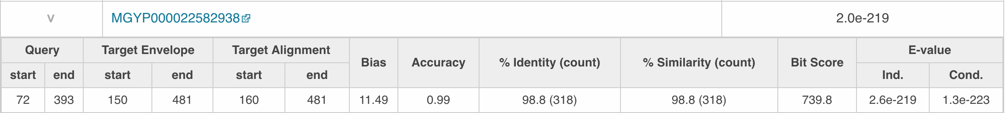
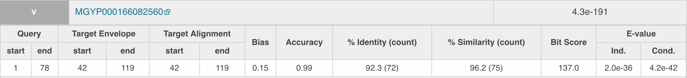
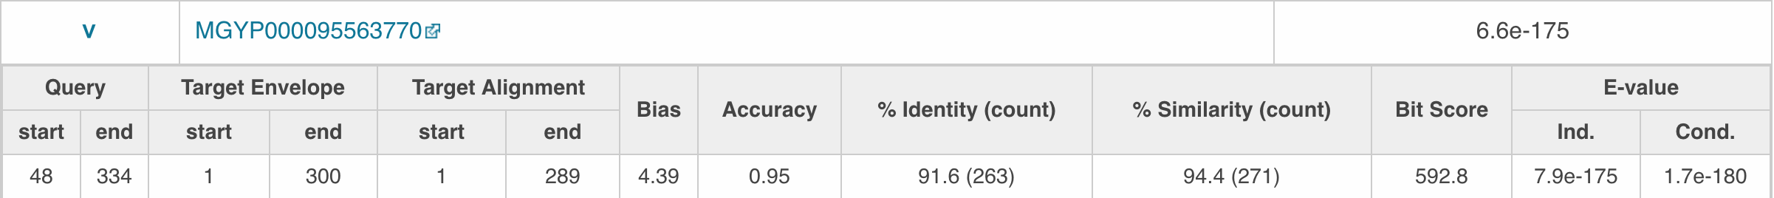
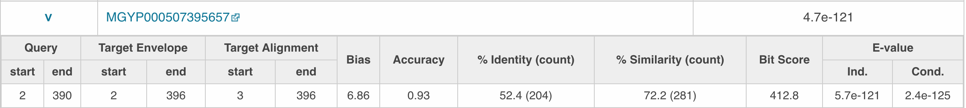
Are these genes gut bacteria restricted?
European Bioinformatics Institute
Non-redundant protein database
for microbe genomes
1466 human digestive: 2671 human digestive:
2671 human non-digestive
1466 human non-digestive: none
From the information in this database, high similarity genes are limited to the human digestive system.
Notes:
Could not access more information about the genes provided. But from this database, it seems that the genes are gut-restricted

Slide 8
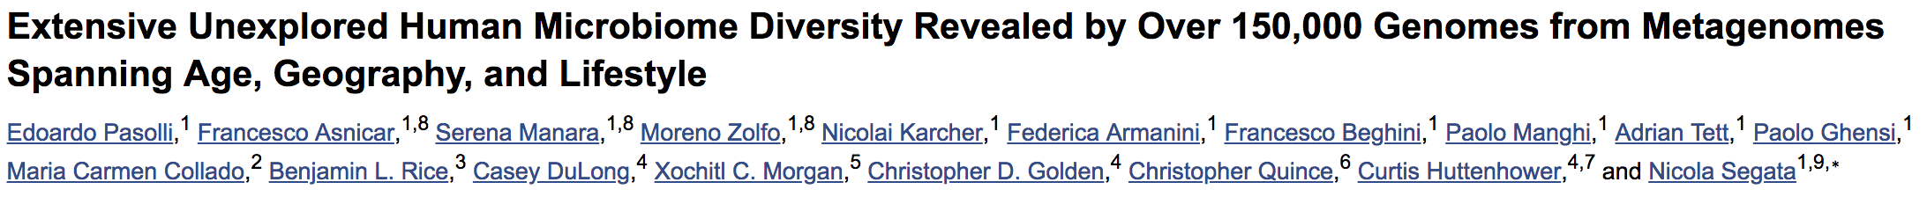
Querying genes of interest against 2019 metagenomic data (77% of species never described before)
154,723 microbial genomes that are recapitulated in 4,930 species-level genome bins (SGBs)
Main file unzipped into thousands of fasta files – concatenated them to be uploaded
Challenges: BLASTing genes of interest against a local database
Genome Workbench (uploaded metagenome data but could not BLAST against)
Geneious Prime (successfully uploaded and functional)
Notes:
Field is rapidly evolving – wanted an updated database to search against, rather than NCBI. 77% of these species did not have genomes in public repositories
Data were from four body sites – oral cavity, skin, vagina, stool
- can’t know if these genes that were detected are gut bacterial in origin

Slide 9
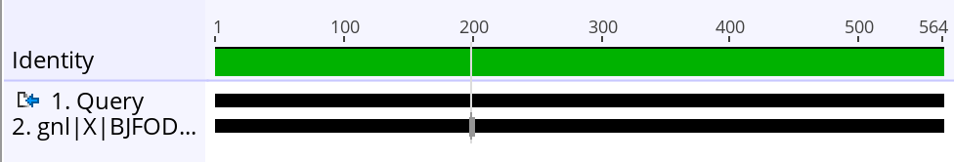
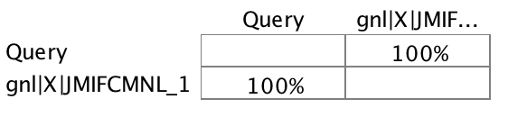
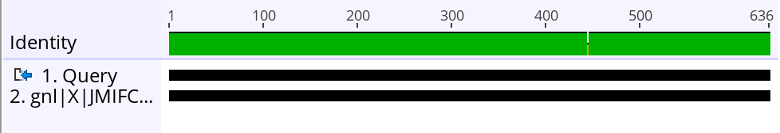
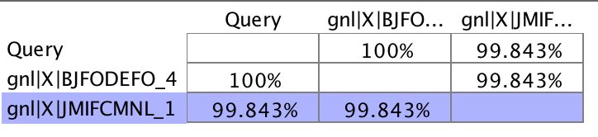
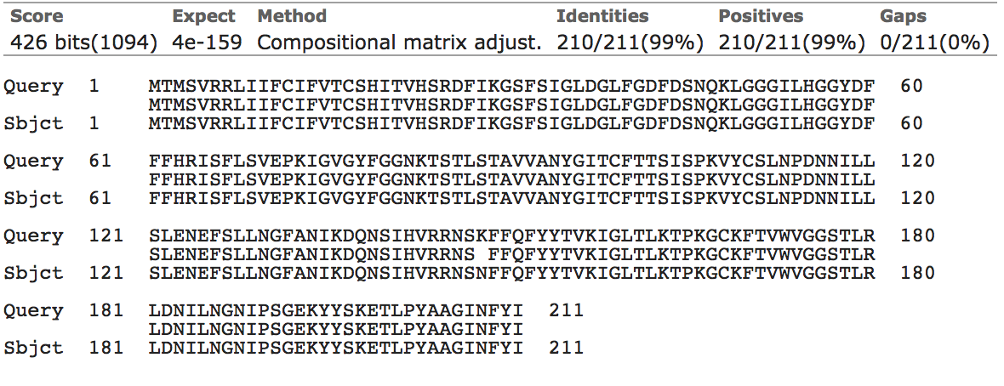
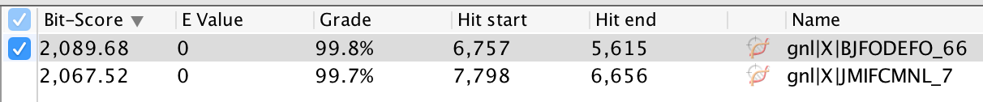
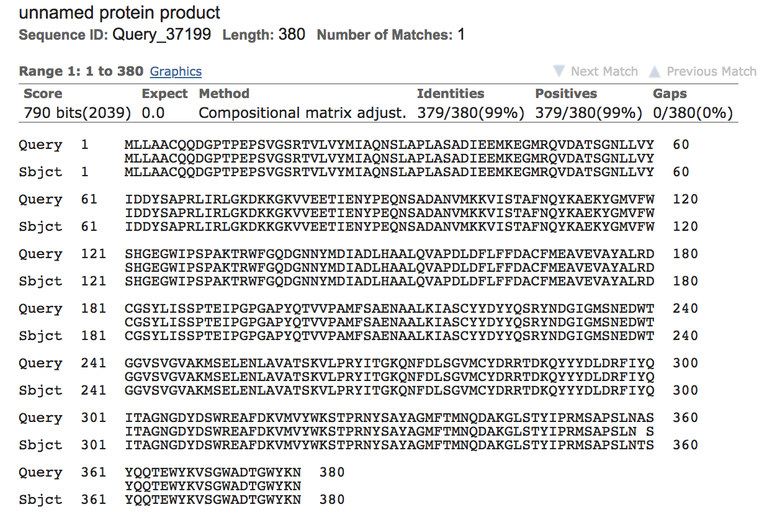
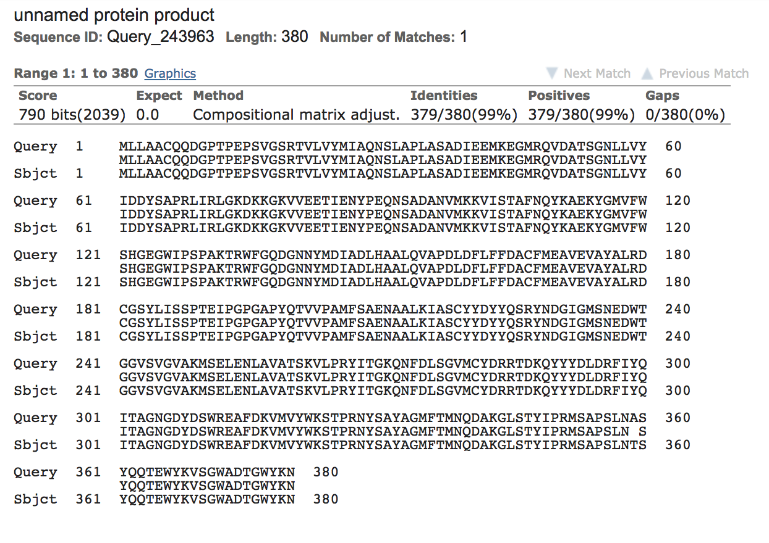
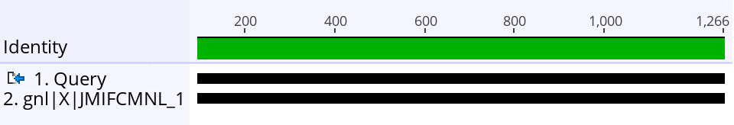
Amino acid conservation across homologues
1464
1465
2671
1466
Notes:
Not sure if these are other bacteroides strains or not. Each bin was in reference to a certain authored paper – from here I wasn’t able to obtain any more information, but likely these are other bacteroides strains.
There might be point mutations that are occurring within Bacteroides species

Slide 10
Future directions
Determine co-occurrence patterns of these genes
Challenges using “multigene blast” (app would not open)
Determine the functional implications of the mutated homologues
(clone gene in B. fragilis to see if phenotype is recapitulated)

Slide 11
Thank you

